Slide 1

APP RECOMMENDER
By:
Alekhya Boyapati
Sumanth Koushik
Vinil Kumar

Slide 2
Under the guidance of:
Dr. Yugyung Lee
TA: Feichen shen

Slide 3
INTRODUCTION:
Significant increase in the number of mobile web applications.
Around 9 billion mobile users in the world today and this number is
expected to increase to 24 billion by 2020.
Google play store reached 1 million apps from total 5,00,000 last year.
Apple hits 9,00,000 apps this year.

Slide 4













Example:
For Black Friday deals the number of apps created are: nearly 15
Black Friday, Black Friday 2013 ads, leaked black Friday ads, black Friday app by slick deals, black Friday 2013, coupons app by right buy, black Friday tips and tricks, etc..

Slide 5
MOTIVATION:
In the present Mobile web application industry, selecting required application for our mobile phone is becoming more hectic for user as numbers of applications for each purpose is increasing exponentially every day.
Time has arrived where in another Mobile Web application needs to be developed to give the user with an intelligent, more efficient application according to his/ her needs.

Slide 6
OBJECTIVE:
Our project aims at developing Mobile web application which provides users with best suited app for their phone and requirement and also suggest them related applications along with their genuine reviews.

Slide 7
Approaches and features
App Recommender mainly consists of two features:
Choosing category and viewing apps
Managing interests and getting emails
In ‘Choose Category’, a category can be selected from 27 different categories and then all the best rated apps are displayed in that category for the user to download and use them.
In ‘manage interests’, user can his manage interests and receive emails weekly.

Slide 8
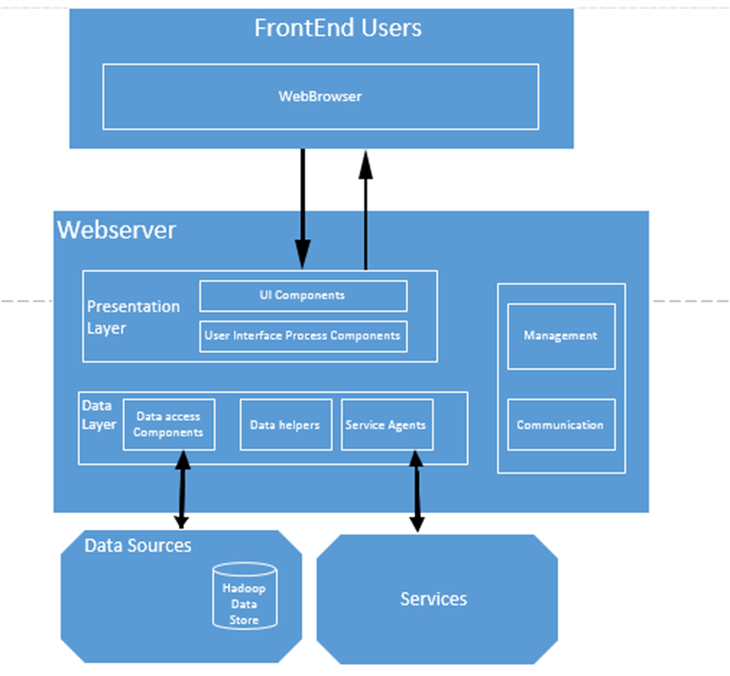
System Architecture:

Slide 9
Evaluation:
The main significance of this APP RECOMMENDER is we can save time of the user and prevent adding of redundant data.
The major limitation of this project is there is no dynamic data involved. So, we need to manually add the new apps for making changes.

Slide 10
THANKYOU

